Slide 1


Travel and Tourism Management System
“Everything you've ever wanted is sitting on the other side of fear.”

Slide 2


Travel and Tourism Management System
Technologies Used: Java, Swing, AWT, MySQL
Institute: Shri Guru Gobind Singhji Institute Of Engineering & Technology, Nanded
2022BCS037
Rubina Rahimankhan Hakim
A-17

Slide 3
Introduction
Travel and tourism industry needs efficient management system.
Objective: Simplify and digitize travel management tasks.
Purpose: Enhance user convenience for booking, updating, and managing travel services.

Slide 4
Features
User Management: Add, update, and delete customer details.
Package Details: View and book travel packages.
Hotel Booking: Select hotel packages with options for food and AC.
Integration with MySQL: For reliable data storage and retrieval.
Dynamic Pricing: Based on user inputs like number of days, persons, and services.

Slide 5
Technical Overview
Tools and Technologies
System Architecture
Programming Language: Java
GUI Frameworks: Swing and AWT
Database: MYSQL
Backend Connectivity: JDBC
Development Environment: Visual Studio
Frontend: Java Swing-based GUI for user interaction.
Backend: MySQL database for storing user and booking data.
Middleware: JDBC for seamless database connectivity.

Slide 6


















customerId
Name
City
noOfDays
BookingId
Street
Address
Address
Phone
State
Foodincluded
Customer
Email
Books
Hotel Booking
Chooses
PackageId
roomType
customerId
Travel Package
hotelname
customerId
Package name
Price

Slide 7
customer
Hotel Booking
customerId
Name
Email
City
Street
State
BookingId
Foodincluded
noOfDays
customerId
roomType
hotelname
Relational Table
Travel Package
Phone no
PackageId
customerId
Package name
Phone

Slide 8
Core Functionalities
Customer Module:
Add new customer.
Update existing customer details.
Retrieve and display customer information.
Travel Packages Module:
Display travel package details.
Book travel packages.
Hotel Module:
Calculate total cost dynamically.
Insert booking details into the database.

Slide 9
Project Highlights
Key Highlights
Challenges and Solutions
Intuitive and interactive GUI using Swing and AWT.
Real-time database operations with JDBC and MySQL.
Modular design for flexibility and future scalability.
Error handling and data validation at multiple levels.
Challenge: Designing a user-friendly GUI.
Solution: Iterative design with user feedback.
Challenge: Ensuring smooth database connectivity.
Solution: Proper JDBC configuration and exception handling.

Slide 10
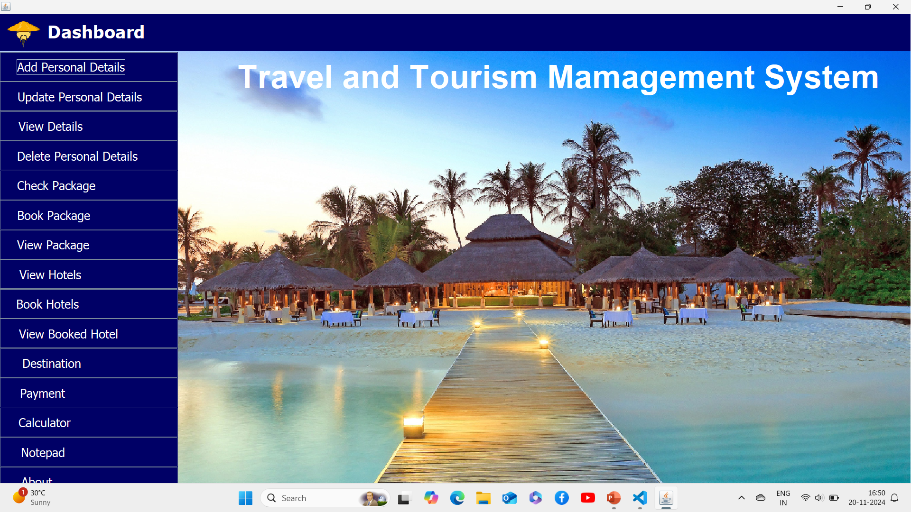
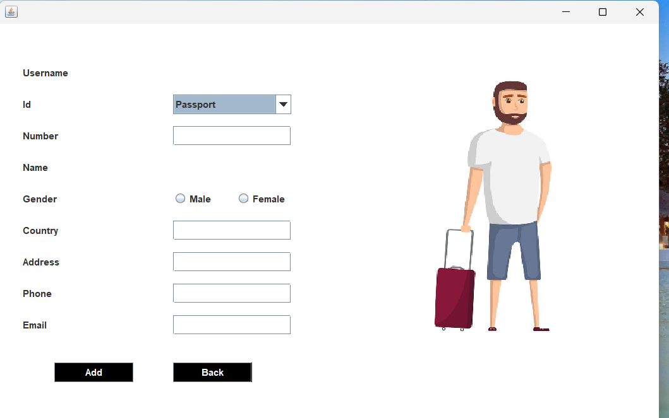
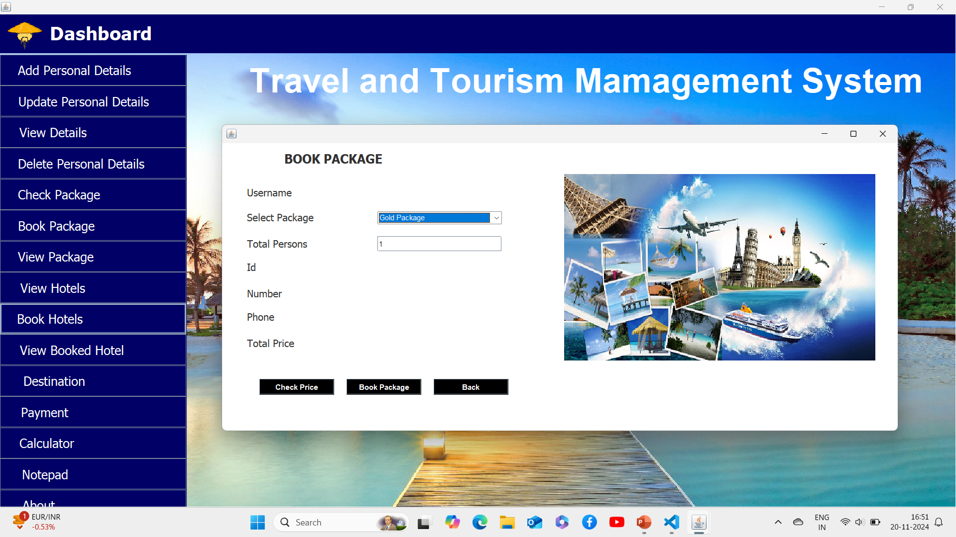
Demo Screenshots
Dashboard Screen
Customer Details
Package Details
Shows overall layout of the Project
We can add customer details in this Screen
To book customer package with dynamic pricing.

Slide 11
Conclusion
Simplified travel management through digitization.
Learnings: Improved understanding of Java GUI and database integration.
Future Scope: Add online payment and mobile app support.

Slide 12
Thank You
I would like to express my heartfelt gratitude to Misha Ma’am for giving me the opportunity to work on this project as a part of our in-semester DBMS coursework. Her guidance, encouragement, and valuable feedback have been instrumental in the successful completion of this project.
I am also thankful to peers for their continuous support and constructive suggestions throughout the project. This experience has greatly enhanced my understanding of database management systems and Java application development.
Finally, I would like to acknowledge the resources and tools that facilitated my work and helped me achieve the desired outcomes.

